Slide 1
Predictive Modeling
27 OCTOber, 2021

Slide 2
Answering Q3
What attributes of external support (externally provide training, coaching, DESE support) influence the rate of improving instruction? What are the conditions that cause the contribution of these variables to vary?
“Improving instruction”: increase in ETLP domain on CWIS
Possible influencing variables
Q3 part (Training format: virtual learning platform or trainer or both)
Datasets: CWIS & Coaching Logs
Possible Question:
Does the consistency of coaching influence the rate of improving instruction?

Slide 3
Consistency Measure
Frequency
Once per month
No. of times per month
Gap/Stop
No. of empty month
Duration of coaching session

Slide 4
Target Data Table
Aggregate CWIS, Coaching logs & NCES --> 1 district format
Aggregate <- DT[ , (), by = (State.District.ID, year)]
State District ID | Year | Consistency Measure
MO-002097 | 2019
MO-002097 | 2020
MO-004110 | 2019
… | …
Each rows ---> different districts in different years

Slide 5
Datasets
contains the State District ID, district name, building name, survey data of the coaching
CWIS
Rows 80,317 x Columns 106
Each rows represents a survey response of a school/building within a district
ETL AVERAGE comes from CWIS
Building/school level data

Slide 6
Datasets
contains the State District ID, timestamp, duration of event, interaction type of the trainings occurred, description of the learning patterns.
Coaching Logs
Rows 11,556 x Columns 58
Each row represents coaching session between the educator and the school
Data created from the survey of 2020 - 2021 DCI CST Consultant Report
District level data

Slide 7
Merging of the data
CWIS
State District ID
Coaching Logs
Not Optimal
Approach
Rows = 4615311, Columns = 169

Slide 8
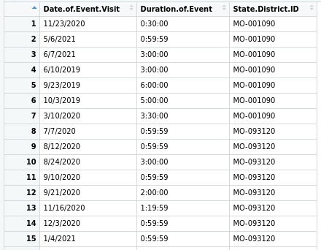
Coaching Data
Relevant Columns = 3
Total observations = 5,924
Columns = 3

Slide 9
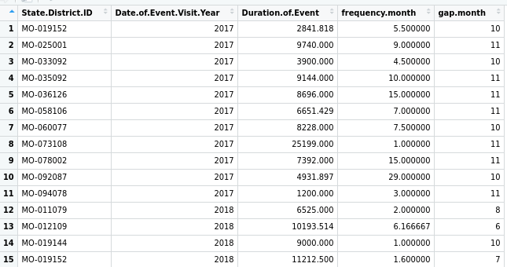
Aggregate Coaching Data How?
Aggregate <- DT[ , (), by = (State.District.ID, year)]
Total Districts = 540
Columns = 5

Slide 10
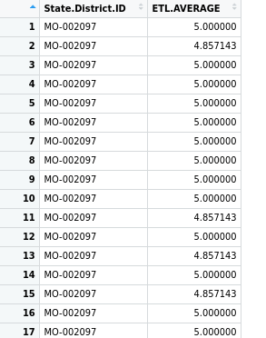
CWIS Data
Relevant Columns = 2
Total observations = 80,267
Columns = 2

Slide 11
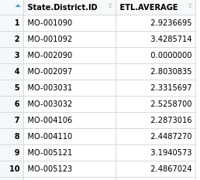
Aggregate CWIS How?
Operation = MEAN between the survey values of different schools in same district
Aggregate <- DT[ , mean(each_column), by = State.District.ID]
Total Districts = 230
Columns = 86

Slide 12
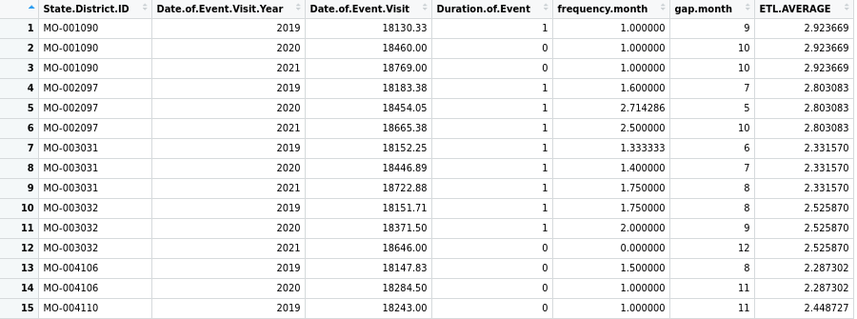
Aggregate(CWIS, Coaching Logs)
Duration of event
- Less than half day = 0
- Half day = 1
- Full day = 2

Slide 13
Aggregate(CWIS, Coaching Logs)
Rows = 533, Columns = 7
Unique districts+years are taken
Each row represents cwis survey per district and coaching level data
Some districts had cwis survey data but no coaching logs data

Slide 14
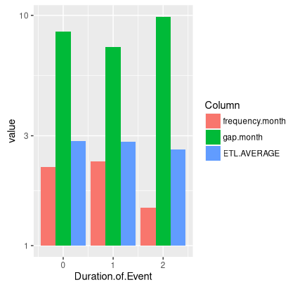
Merged Data Analysis

Slide 15
Questions
Should we aggregate the data based on academic year eg. August-March 2019-2020?

Slide 16
Baseline/Featureless Models
Simple Models that provide reasonable results with arithmatic functions
Baseline predictions -> independent of inputs
Why use Baselines?
If baseline models perform better than our models -> the inputs have no relation with the outputs
Baselines Used:
L1 -> Regression Baseline -> Median
L2 -> Regression Baseline -> Mean

Slide 17
OrdinalNet
In statistics, ordinal regression is one kind of regresion analysis ued for predicting ordinal variables with ordered categories
It can be considered an intermediate problem between regression and classification.

Slide 18
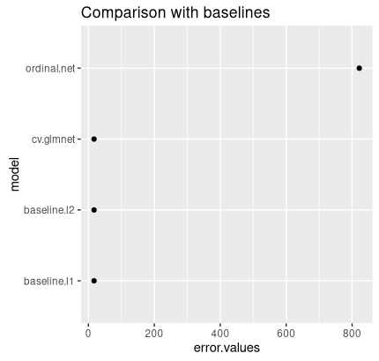
Comparison of models

Slide 19
Future works
Merge the three datasets for the training format question
Apply models with the dataset

